Slide 1
IntelliBus Final Presentation
December 6, 2021
ECE-4872-L10
Group Members: Noah Chong, Shadman Ahmed, Thomas Talbot, Yue Pan (David)
Primary Advisor: Dr. Vijay Madisetti
Notes:
Noah

Slide 2
Problem
Human congestion in public areas and transportation leads to money spent on inefficient public transportation and higher rates of virus transmission and exposure.
Local governments are looking for ways to reduce costs and more efficiently utilize public transit.
Notes:
Noah

Slide 3
Solution
IntelliBus provides real-time passenger data capture and analytics, so that transportation authorities can better utilize resources and provide a better service to their customers.
Notes:
Noah

Slide 4
Description
Project Goal - design and prototype an IoT device that will track bus location and the aggregate number of riders.
Passenger Counting System | Cloud-Based Web Application
Infrared Sensors LIDAR Sensors Microcontroller LTE-M module GPS antenna | AWS IoT gateway with public IP address noSQL database on AWS Website with chart JS dashboards and OpenLayers maps API
Notes:
Thomas -
This slide gives a high level description of the project. The goal is to design and prototype an IoT device that ultimately displays real-time updates of bus location and total passengers on a cloud-based web application. We have divided the project into two main components. The embedded passenger counting system will contain infrared sensors or LIDAR sensors to capture passengers entering and exiting the bus doors, a microcontroller that will process sensor inputs and store the total passenger count.
And an LTE-M module on the microcontroller will transmit the current number of bus riders and bus location to an IoT gateway.
The second component of the project is a cloud-based web application that will be built upon a noSQL database of time-stamped passenger counts. AWS IoT Core is the gateway that will connect the embedded passenger counting system with the back-end noSQL database. A web page will actively refresh with the latest passenger counts and bus locations pulled from the database. For the front-end, we we plan on using tools like chart JS for data visualization and the OpenLayer maps API. These tools will allow End-users like Transportation departments and bus riders to analyze passenger traffic statistics and bus maps on our website.

Slide 5

Customer Requirements
Target User - Transportation Departments without passenger data
Requirement | Priority
Accurate display of passenger counts | HIGH
Easy to Install | HIGH
Cost less than $800 | MEDIUM
Timely web application response | MEDIUM
Notes:
Thomas-
the target user of our product is transportation departments that provide bus services and currently do not collect data on passengers. And The highest priority for that customer is to deliver an accurate display of passenger counts and bus locations on our website.
Another top priority is that the IoT solution can be setup easily and affordably across an entire bus fleet. To be quickly setup, our passenger counting system will use an existing bus power supply, and fit within the dimensions of a bus doorway.
our goal is that the product would cost no more than $800.
- Transportation departments will only purchase our product if bus passengers are pleased with the website display. to keep passengers happy, the website we design should respond to HTTP requests within 5 seconds.

Slide 6

Engineering Requirements
Requirement | Priority | Customer Need
Transmit to the cloud with a minimum throughput | HIGH | Accuracy & Timeliness
Respond HTTP requests within 5 s | HIGH | Accuracy & Timeliness
Area < 680 cm² | HIGH | Ease of Installation
Charge using 5V USB | HIGH | Ease of Installation
Embedded device cost under $200 | MEDIUM | Cost & Scalability
Notes:
Thomas -
This slide shows how the engineering requirements of the project will meet the customer needs discussed on the previous slide.
The product will fail if it cannot respond to user requests in a punctual fashion. There are two potential network bottlenecks within the system. Between the IoT device and the cloud database, there should be a minimum throughput of 5.6 kbps to allow enough time for data processing. Transportation departments and passengers should receive HTTP responses from the AWS virtual machine within 5 s.
In addition to timing performance, the device should easily integrate into a modern bus infrastructure. The embedded system should charge using a 5 V USB cable and the size should not hinder passenger movement. To be scalable, the total cost of the embedded device hardware should be less than $200. For prototyping, the top engineering goal is to show that the IoT device can accurately display passenger count data on a website within a reasonable amount of time.

Slide 7
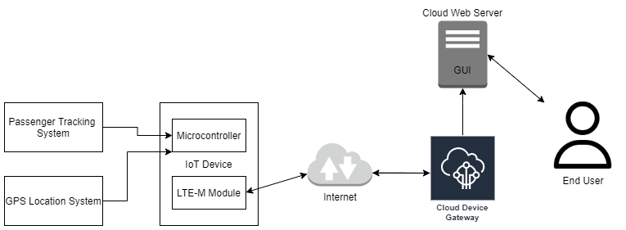
System Overview
Low SWaP IoT Devices & Sensors
Cloud-based IoT Endpoint and Processing
Visualization with Open-source GIS software
End-User access through a web-portal
Notes:
Shad -
There are two main components to IntelliBus: the IoT embedded device and the web applications. The IoT device consists of a microcontroller, tracking sensors, and LTE-M module. The web application is responsible for providing a real-time dashboard of bus locations, passenger counts, and viewing pertinent graphical statistics and analytics. Figure here shows the overall system architecture of IntelliBus

Slide 8







System Overview - Technologies
Visualization
Data Processing
Map Framework
AJAX HTTP
ChartJS
Notes:
Shad --
Here is a little more detail about the frameworks and services that we will be using. For the Visualization and Frontend of the map viz that shows near real-time route information, we will use OpenLayers JS framework. It integrates really well with NodeJS and will provide a simple way to take GeoJSON info and map them appropriately. For the analytics side of the vizluations, we plan to leverage some enterprise level Business Intel

Slide 9
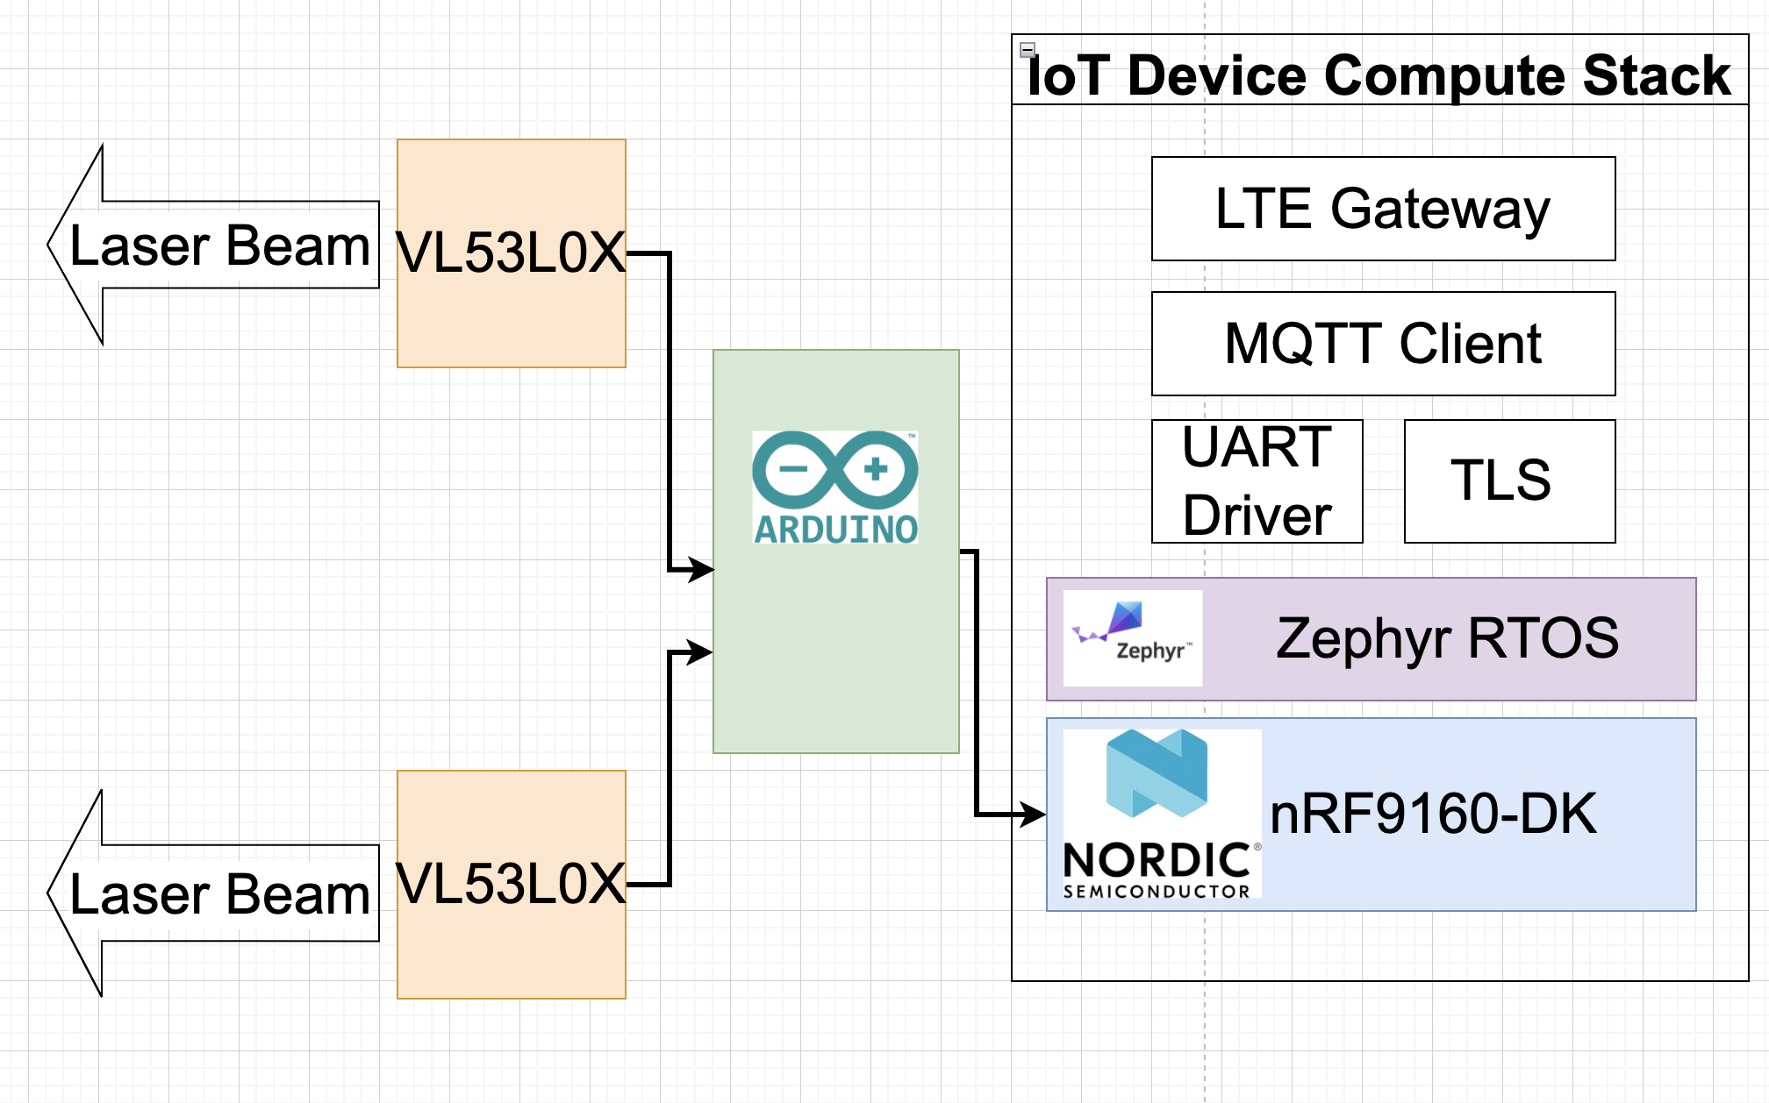
On-Bus Hardware Organization
A pair of LiDAR sensors for each bus door
Sensors are placed facing the passing passengers and set a GPIO pin high when passenger walks by
Arduino Nano reads LiDAR sensors
nRF9160 transmits count over LTE-M
Notes:
The Two VL53L0X LiDAR sensors can accurately measure the distance of the nearest object within 30 mm-1000mm.
The Arduino Nano reads the LiDAR sensors via an I2C interface. If the distance returned by a sensor is less than a set threshold, then a digital output pin is set.
The Nordic Semiconductor nRF9160 transmits passenger counts and other data over the LTE-M network. It calculates passenger count by the order of rising edges from the Nano’s digital outputs.

Slide 10
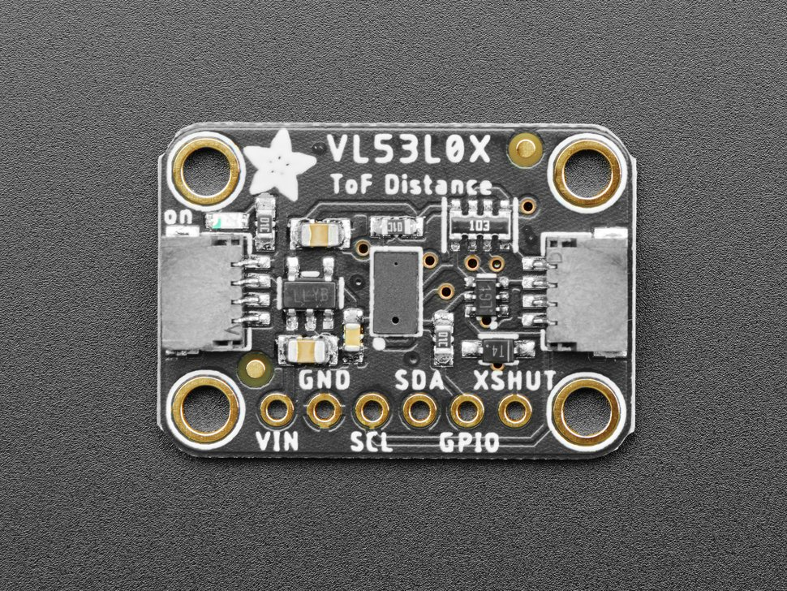
LIDAR Sensor
VL53L0X LIDAR ToF sensor
Time of flight sensors use the travel time of a solid state laser to detect distance
Range: 50mm - 1200mm
33ms delay
I2C communication
Dimensions: 21.0mm x 18.0mm
$14.95
Notes:
David - The LIDAR TOF Sensor uses the speed of light delay from a solid-state laser to measure distance.
If anyone asks ~ It uses a SPAD array (Single Photon Avalanche Diodes) detector and an IR Laser with a 940nm VCSEL emitter (Vertical Cavity Surface-Emitting Laser) controlled by an internal microprocessor all in a module smaller than an pencil eraser. Older IR reflective sensors use the angle of the reflected light from an IR LED to determine distance. Sonar is also used for longer range distance measurements using a reflected ultrasonic signal.
Back to speaking: The LIDAR Sensor is accurate between 50 mm -1200mm which is about 2 inches to 4 feet. The is well within the range we would expect for people moving through a buss doorway. The datasheet predicts a 33ms delay for accurate measurements from the laser, which is preferred over the 3s delay on the original PIR sensors. The VL53 uses the I2C protocol to send measurements to a microcontroller. ( I2C is preferred over SPI due to its NAK/ACK functionality and it requires fewer wires) .
Additionally, the cost and dimensions of this VL53 sensor make it a rational choice for the project.
Initial testing of the LIDAR sensors with the mbed microcontroller were successful this week. The LIDAR sensors were able to quickly respond when motion was detected within a threshold distance. Two sensors placed side by side can count the number of passengers on hypothetical bus using the order of triggers as discussed on a previous slide. The main issue with the LIDAR sensors is that they are only able to detect motion directly in front of the sensor. This problem can be mitigated by placing the sensors at chest height on the bus. A 3D -printed mechanical housing for the sensors will be printed within the next week to allow for more reliable testing.
Depending on the accuracy of the LIDAR sensors in the new 3d printed housing, the team is considering abandoning PIR altogether in favor of the highly sensitive LIDAR sensors.

Slide 11
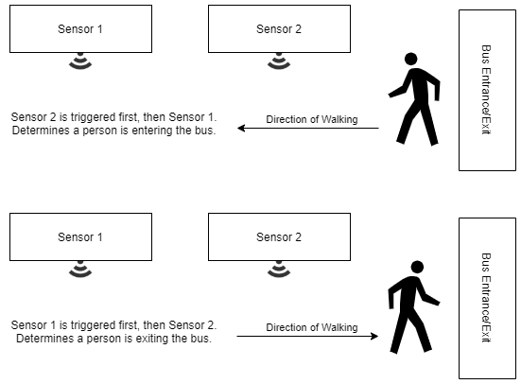
Passenger Counting Mechanism
Two sensors will face the path of passenger’s entry and exit
When passenger moves in / out of the bus, the two sensors triggers at different times
Edge Cases to Consider:
Capturing invalid data while the bus is moving
Person standing in front of the sensors
Preventing double counts
Reliability and timeliness of the sensors
Notes:
David

Slide 12
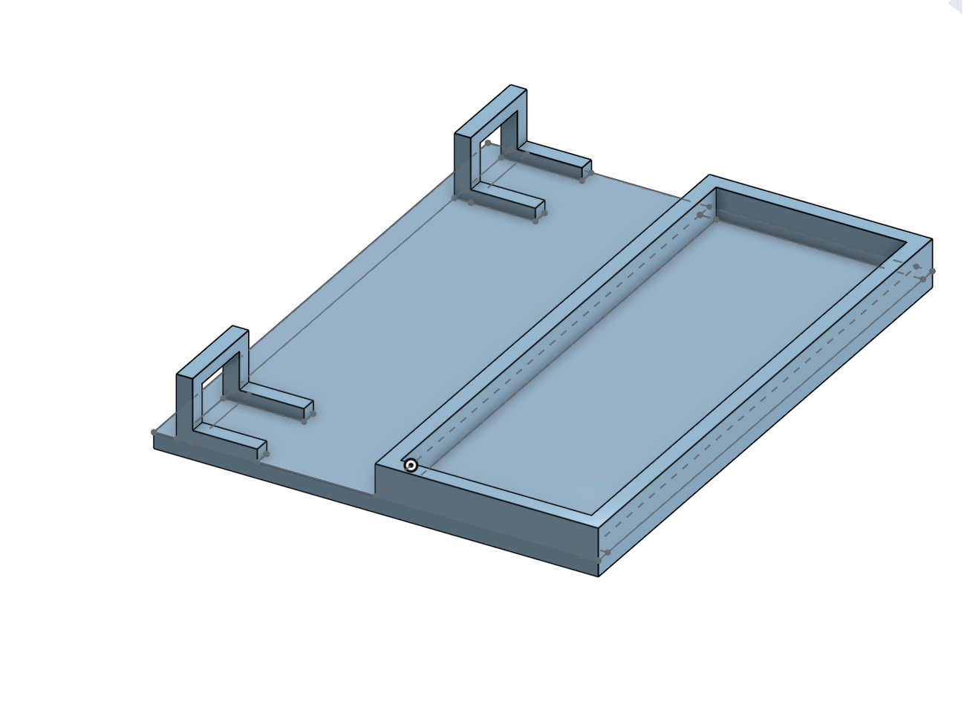
3D LiDAR Sensor Housing
Rectangle with 13.75 cm width and 17.9 cm length
ABS material
Separate housing for Nordic board
Notes:
Thomas - Acrylonitrile butadiene styrene (ABS) is a common thermoplastic polymer.
We have printed out an elliptical sensor housing out of ABS. which provides favorable mechanical properties such as impact resistance, toughness, and rigidity when compared with other common polymers. This material is affordable and its chemical properties make it ideal for our prototype intelliBus system.
The top right image shows the front face of the 3D sensor housing, with variable heights. The heights vary by about 2.5cm (which is about the height of a PIR sensor) . So off the 1cm base, the heights increase to 3.5 cm, 6cm, and 8.5cm. The right hand side image shows the 3 pairs of angles that we can detect human motion (inner pair, middle pair and outer pair). The passenger counting logic assumes that the sensors are triggered one after the other. The curved shaped of the 3d sensor housing helps enforces this constraint. With LIDAR sensors, the overlapping detection field should not be an issue since the LIDAR beam emits a line directly in front of the sensor. However, with PIR sensor detection it is important that the sensors are angled away from each other. If mounted directly side by side, the wide field of view on the PIR sensors could overlap.
Additionally, we are planning on building a separate 3D printed housing for the nordic microcontroller board that will protect the top and bottom of the microcontroller from the elements.

Slide 13
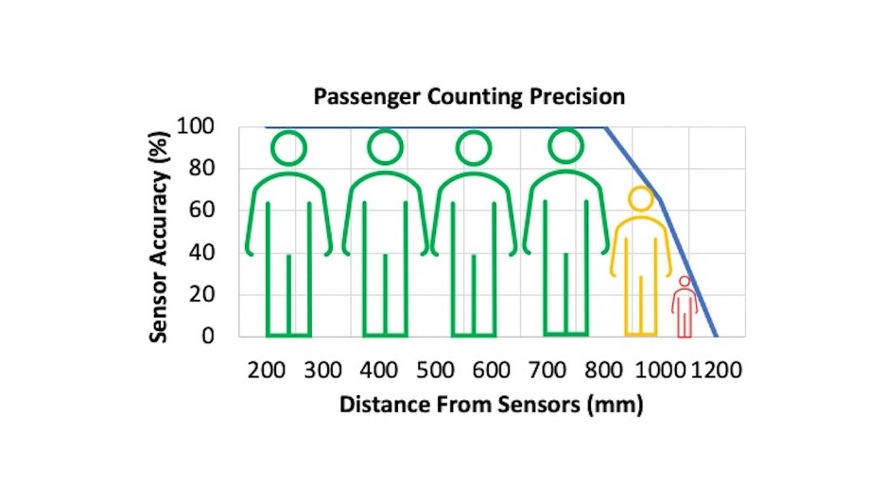
Passenger Counting Precision Results

Slide 14
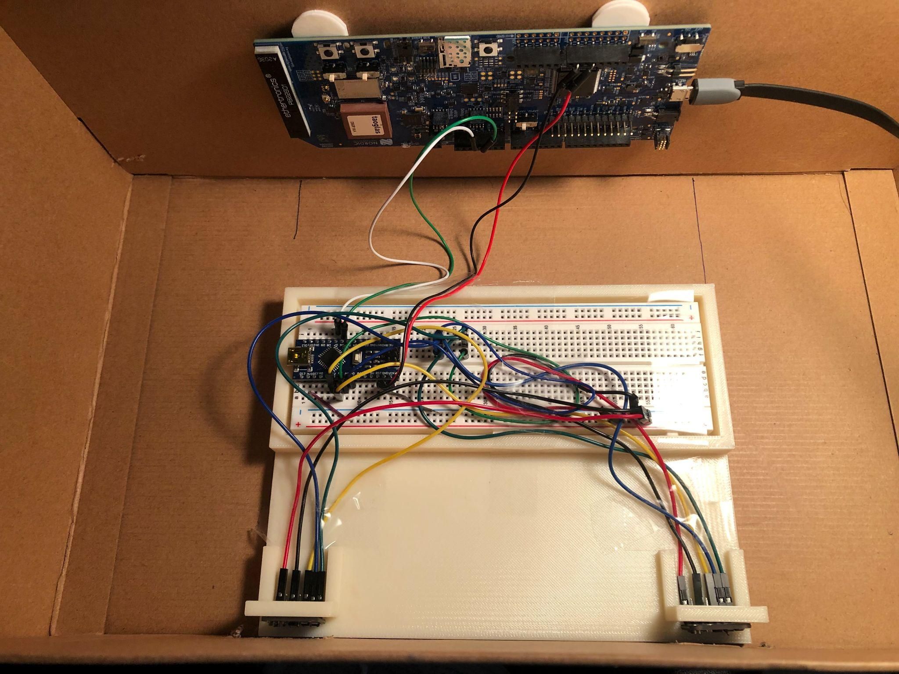
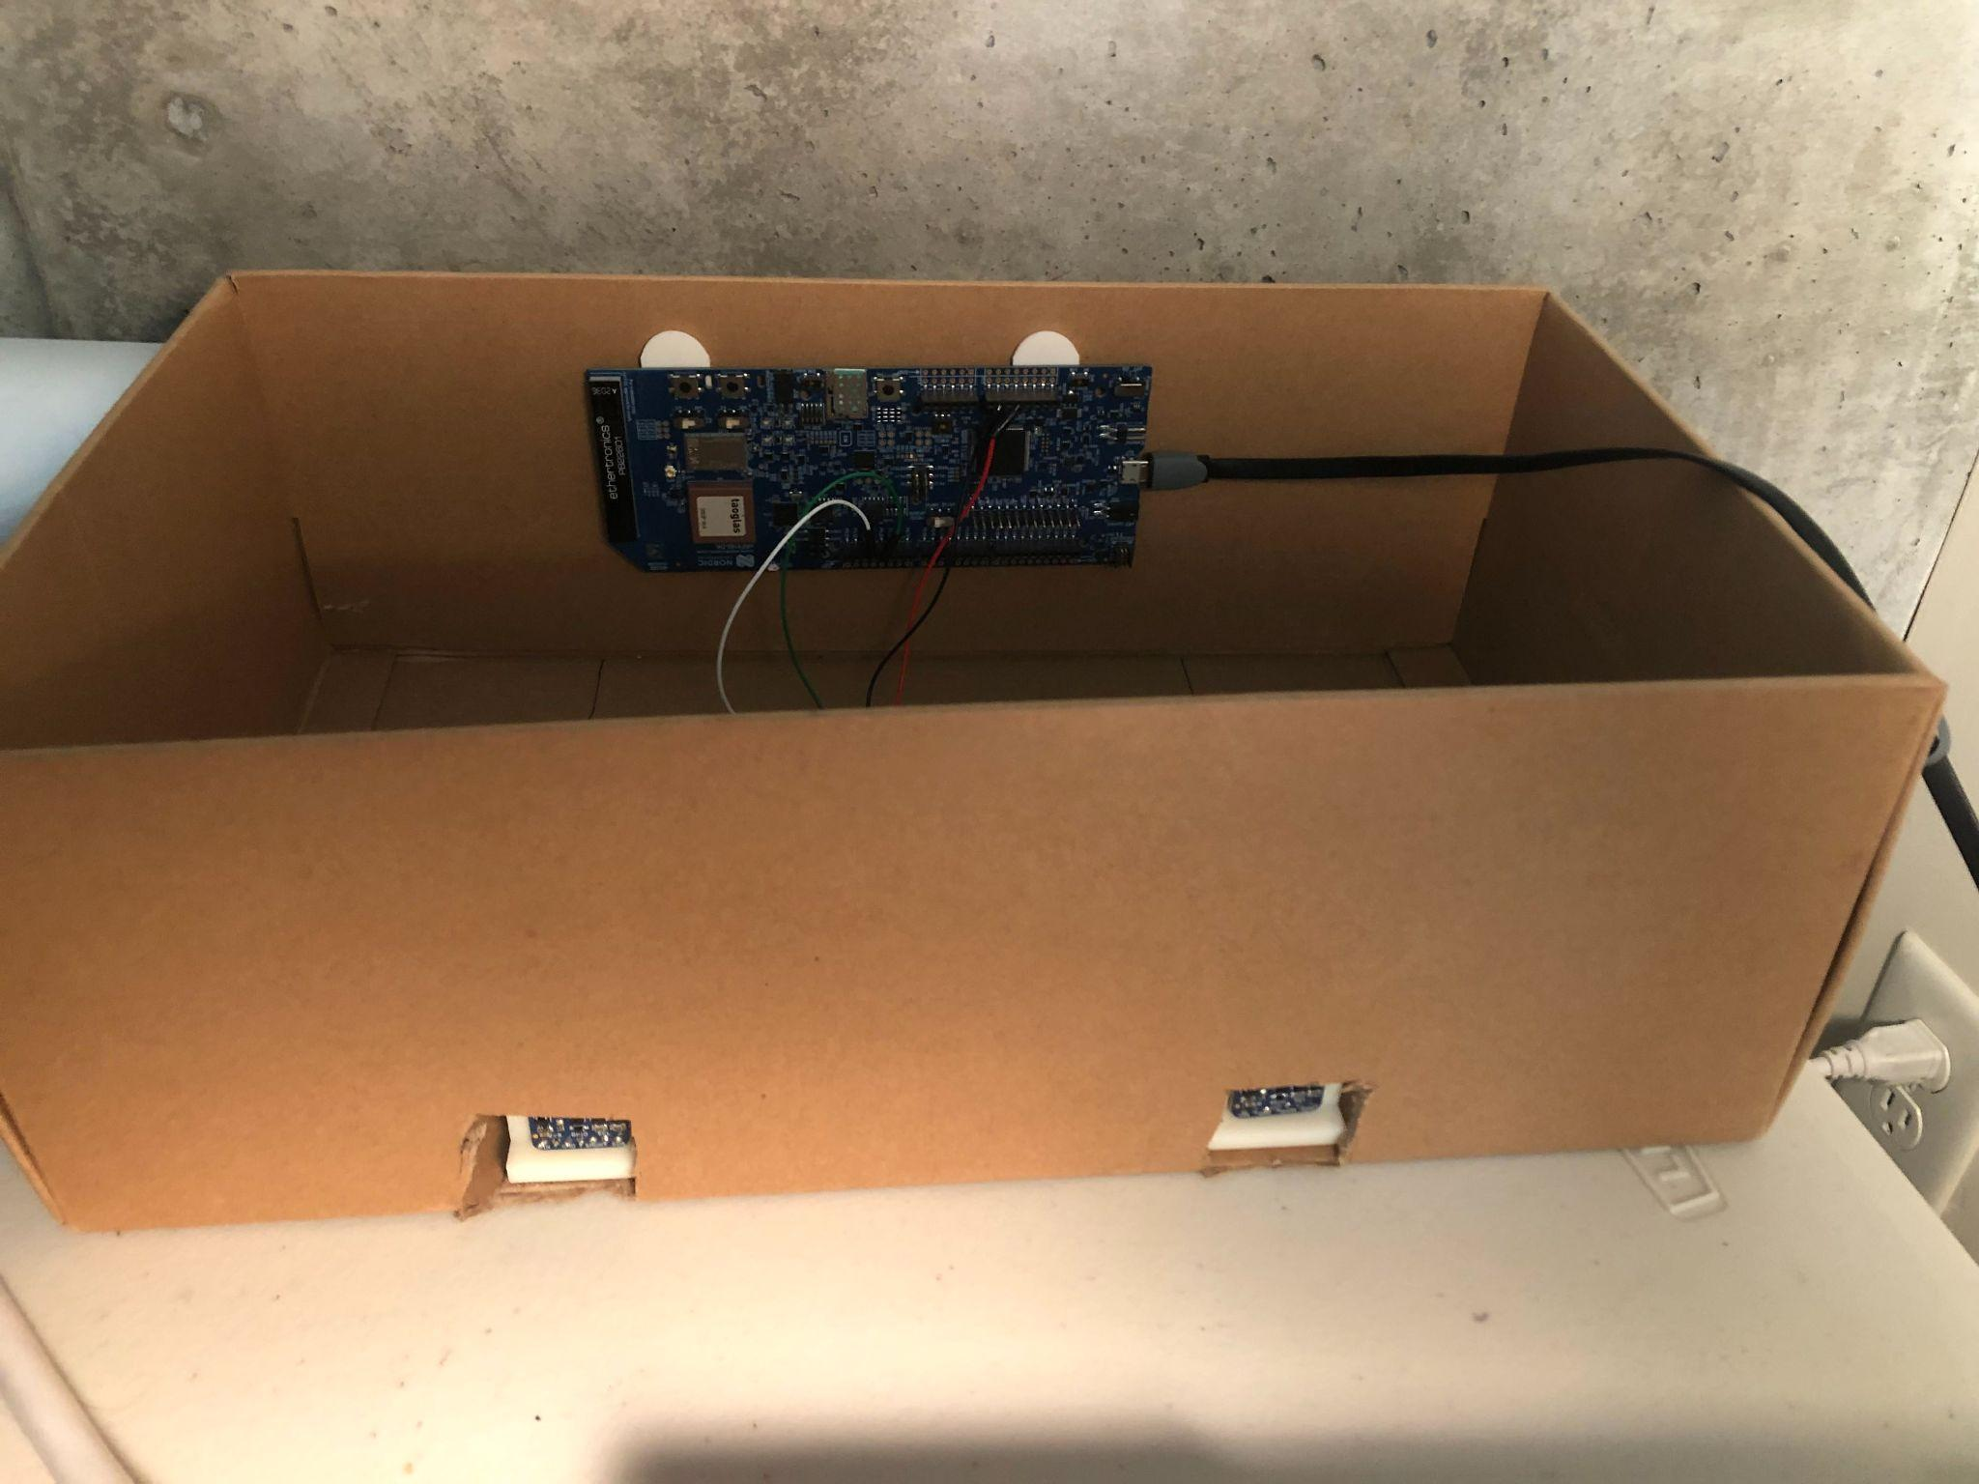
On-Bus Hardware Prototype

Slide 15
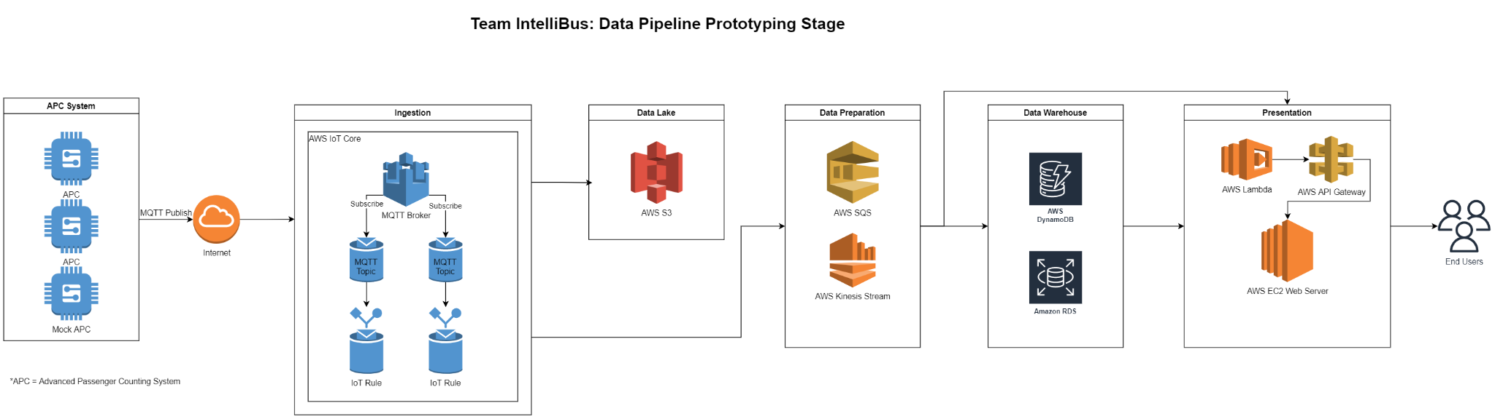
Prototyping Data Pipeline
Notes:
Design for High-Throughput Low-Latency Big Data Pipeline in the cloud

Slide 16
Enterprise Data Pipeline (Scaled Deployment)
Auto Scaling Group -- DynamoDB
Load Balancing -- EC2 Instance
Data Lake -- Archiving to Glacier
Machine Learning -- AWS SageMaker or AWS EMR

Slide 17
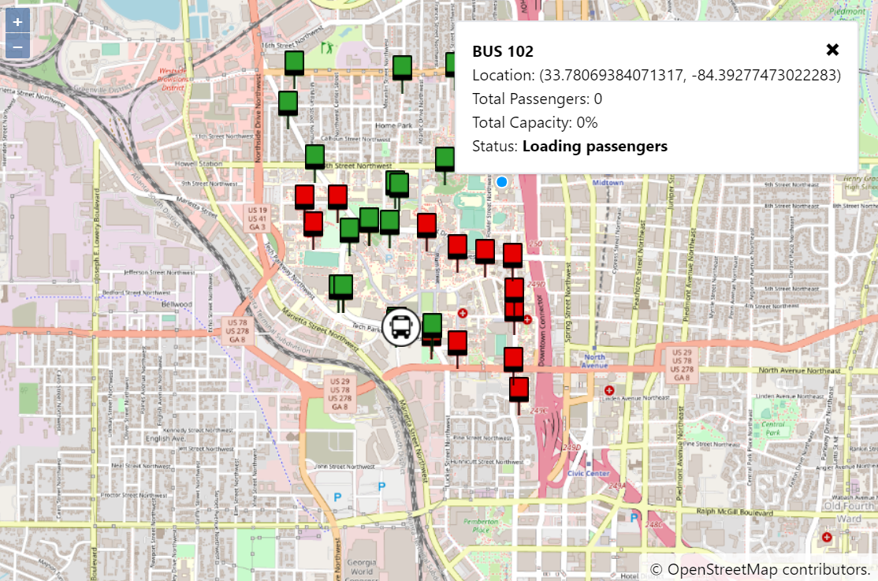
Map Display
Catalog of all bus stops
HUD of bus/route information
Total passengers
Total capacity
Current bus status
Notes:
Noah
May use this:
Shad --
The web application pulls from the database to present the end-users with live maps and passengers counts
The live-feed webapp proposed GUI for the live map and passenger count.
The analytics dashboard will provide web-embeddable machine learning business intelligence (BI) GUI dashboards -- either using AWS Quicksight or Microsoft PowerBI -- which will allow end-users to have insights on the data and make predictions.

Slide 18
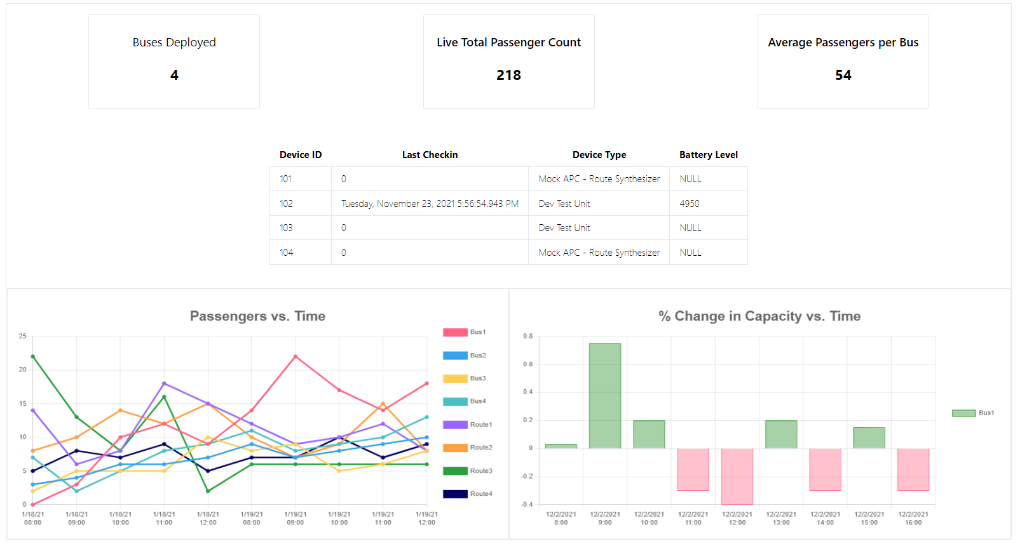
Analytics Dashboard
Notes:
Noah
May use this:
Shad --
The web application pulls from the database to present the end-users with live maps and passengers counts
The live-feed webapp proposed GUI for the live map and passenger count.
The analytics dashboard will provide web-embeddable machine learning business intelligence (BI) GUI dashboards -- either using AWS Quicksight or Microsoft PowerBI -- which will allow end-users to have insights on the data and make predictions.

Slide 19
Schedule
Sep. 11th
Oct. 10th
Oct. 23rd
Nov. 23rd
Dec. 7th
Setup
Local Environments
Hardware setup
Small-Scale Integration
Hardware and IoT communication
WebApp and Visualization integration
Total System Integration
Sensor → IoT → Backend → Visualization → WebApp
Presentation
Package repo & demo
Expo Presentation
Notes:
Noah

Slide 20

Updated Budget
Product | Cost
Cellular IoT Development Kit x2 | $276.00
Infrared Sensors | $10.00
LIDAR Sensor x4 | $0.00 (from lab)
Wires and Connectors | $10.00
External GPS antenna | $11.00
Total Parts Expense | $307.00
Using open-source software tools and AWS free-tier helped save on cost.
Funding ($125 per student): $500
Parts Expense: ($307.00)
_______________________________________
$193.00
Notes:
Thomas - The budget from the original proposal presentation has been updated to reflect the money that has been spent by the team up to this point in the project. The equipment for a prototype of the IntelliBus system includes the cellular IoT development kit, infrared and LIDAR sensors to track passenger motion, an external GPS antenna, and additional wires and connectors. The Nordic Semiconductor cellular IoT development kit is the most expensive item in the budget at $138.00 [7]. We have purchased two boards for parallel development. Passive infrared sensors come in batches of 6, and the per batch cost is $10 [20]. Wires and connectors are estimated to be around $10 as well. The LIDAR sensors are $14.95 each. However, the team already purchased the LIDAR sensors for a previous class (ECE-4180). The external GPS antenna is $11.00. Bringing the total Parts expense to $307.00
The embedded software development environment will come included with the cellular IoT kit. The prototype should not need more than 10GB of standard storage and will use Amazon Web Services' free-tier. Using open-source software tools for the front and back-end of the website will also help save on cost.
The funding for the project is $125 per student, leaving us $193.00 below the top of our budget. Using the current evaluation, there is no indication that the project will exceed the funding provided by the ECE department.

Slide 21

Applications & Competitors
Public Transportation
Airlines
Predictive maintenance
Shopping centers
The Transit Bus App
The Smart Transit People Counting Camera from Beijing Vion Technology
Passio Technologies APC
Notes:
Thomas - The people counting technology used by the IntelliBus system is ultimately not limited to bus transportation. Our product could be marketed to other types of public transportation like metro subway services and passenger rail services. Airlines, predicting maintenance inside a crowded structure, and shopping centers may also have a commercial interest in our system .
There are a couple of products already in existence that offer a similar service to IntelliBus. The Transit Bus app provides real time bus tracking and trip planning with categorical crowding information by describing busses on a mobile app as not crowded, some crowding, or crowded. Like IntelliBus, Transit uses side by side infrared beams to detect human movement [1].
The Smart Transit People Counting Camera from Beijing Vion Technology offers image acquisition, passenger counting and analysis, and network data transmission, all in one camera. The product is mounted vertically over a bus door and uses computer vision and machine learning to detect human motion [2].
Passio Technologies APC (Automatic Passenger Counting) is an advanced system that allows bus transportation authorities to track passenger counts and vehicle service start and end times. Passio also provides a mobile data terminal that displays vehicle location, date, time, passenger type, and other pertinent information on a web dashboard.
If brought to market, the IntelliBus system would provide mostly the same features as the passenger counting systems that already exist.

Slide 22
Leadership Roles
Noah Chong - Webmaster, Frontend Software Lead, Expo Coordinator
Shadman Ahmed - Project Leader, Backend Software Lead
David Pan - Financial Manager, Embedded Systems Co-Lead
Thomas Talbot - Embedded Systems Co-Lead, Documentation Lead
Notes:
Thomas -
Noah Chong will serve as …
Team members may be called upon to assist in other areas of the project depending on the workload.

Slide 23
Any Questions?

Slide 24
References
[1] Transit, “What do bus riders want? Crowding info.,” 31-Aug-2020. [Online]. Available: https://archive.transitapp.com/what-do-bus-riders-want-crowding-info-db89b6d0b5ec. [Accessed: 18-Oct-2021].
[2] “Smart Transit People Counting Camera,” Vionvision. [Online]. Available: http://vion-tech.com/en/industry/27.html. [Accessed: 18-Oct-2021].
[3] “Passenger Counting,” Passio Technologies, 03-Apr-2020. [Online]. Available: https://passiotech.com/passenger-counting/#. [Accessed: 26-Oct-2021].

